Slide 1
Azure Data Warehouse In-A-Day
03.SQL DW Data Loading Best Practices
Steve Young - Data & AI CSA
Rebecca Young - Data & AI CSA

Slide 2
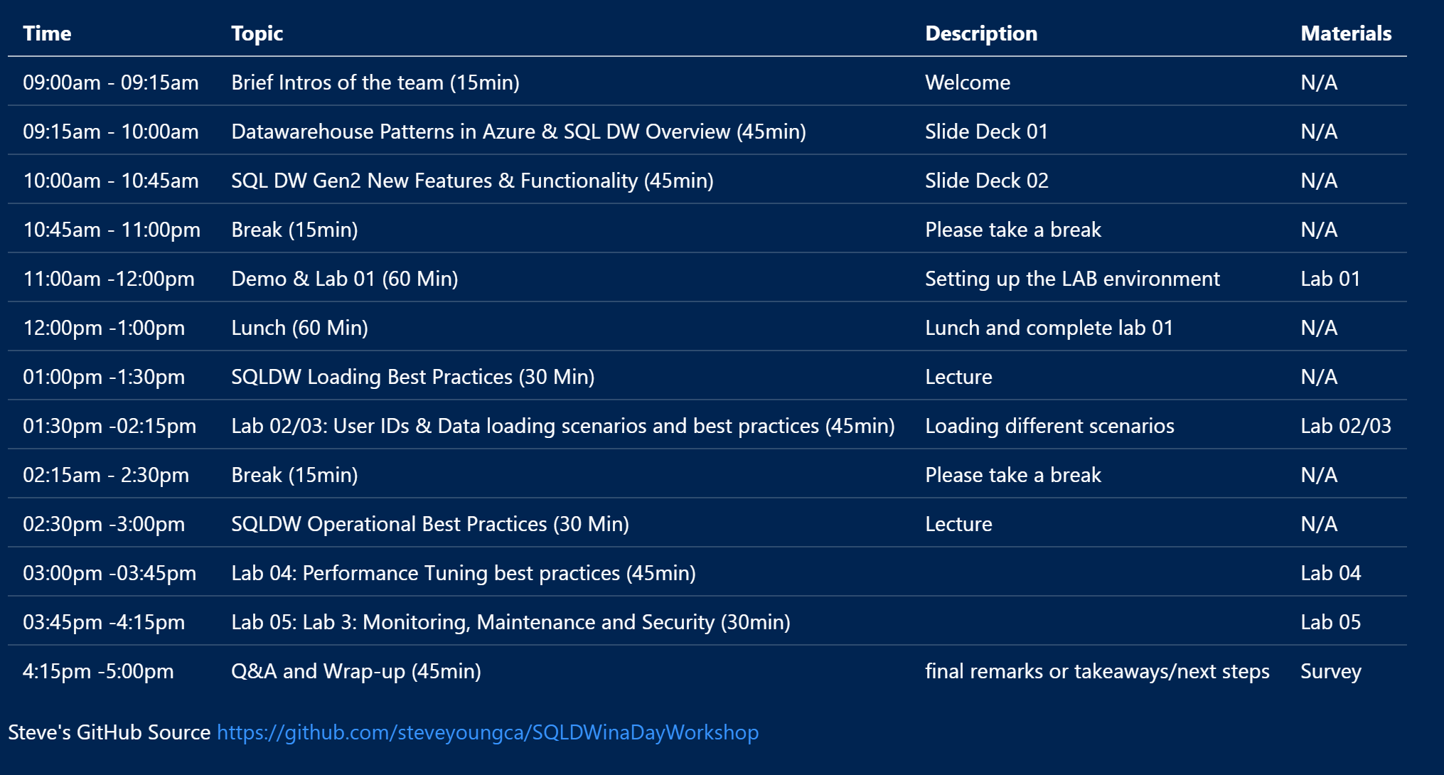
Agenda - TBD
Notes:
Quickly go through Test Cases to refresh everyone and relate them to agenda topics for the day

Slide 3
Important Info
WIFI -
PWD –
File Location - https://github.com/steveyoungca/SQLDWinaDayWorkshop

Slide 4

SQL DW Data Loading Best Practices

Slide 5
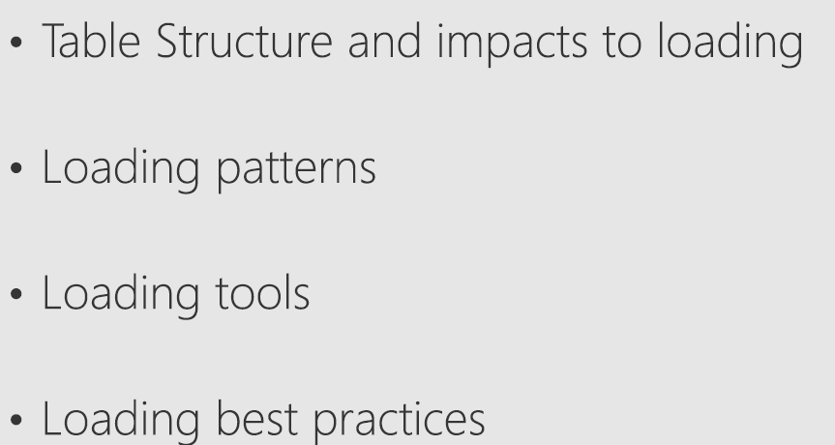
Topics

Slide 6
Physical Structures

Slide 7
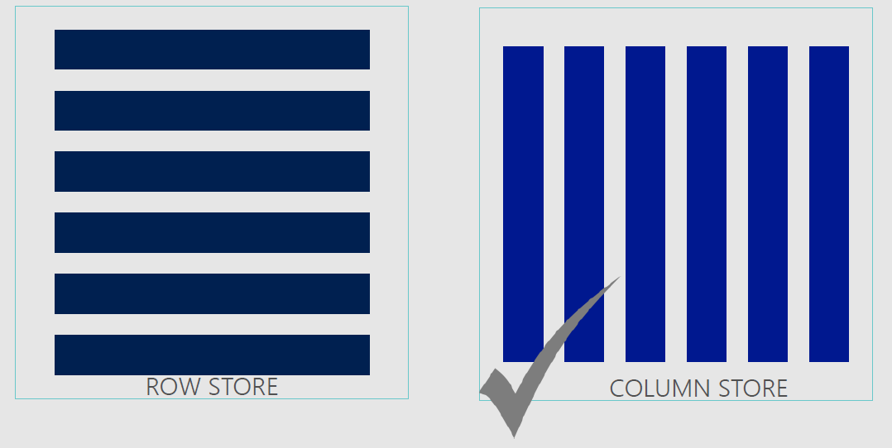
Row store & Column Store

Slide 8
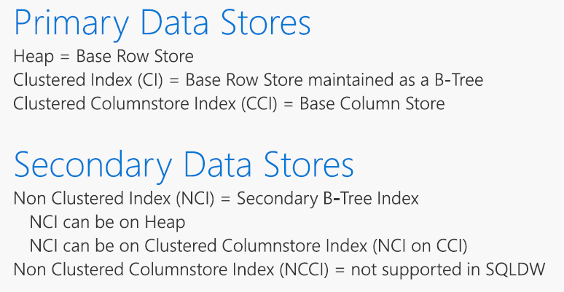
Table and Index Terminology

Slide 9
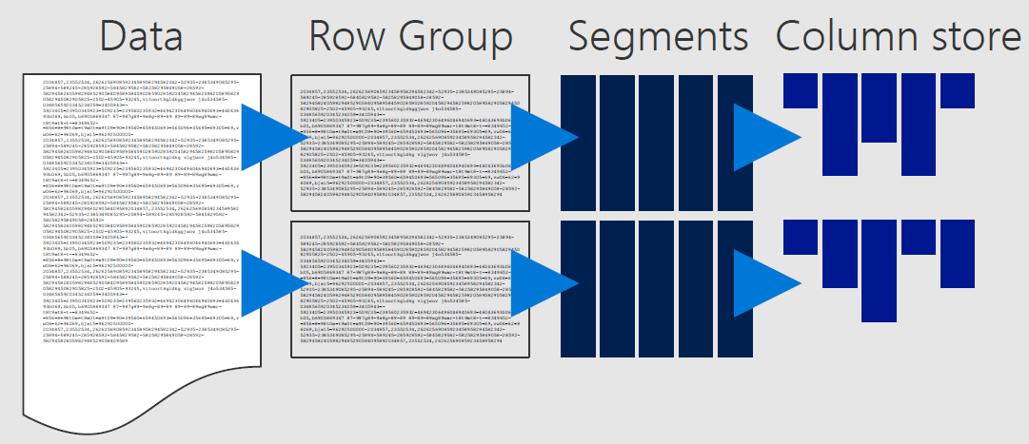
Column Store Taxonomy

Slide 10
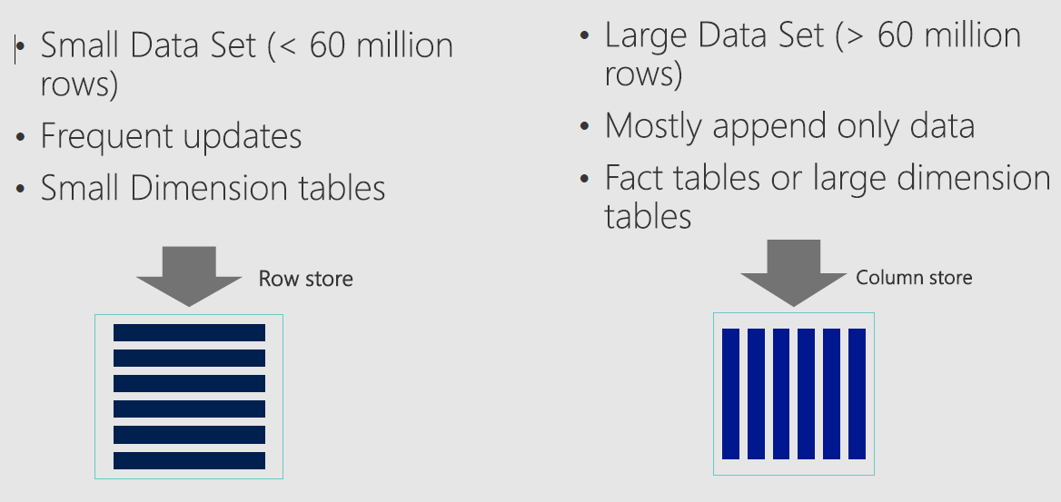
Row store or Column Store

Slide 11
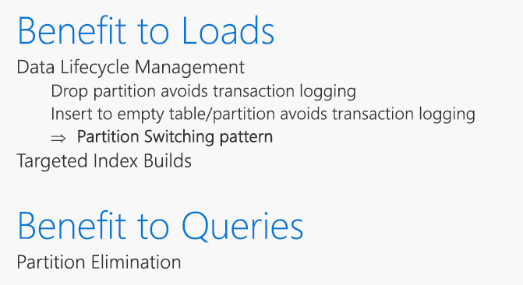
Why Partition

Slide 12
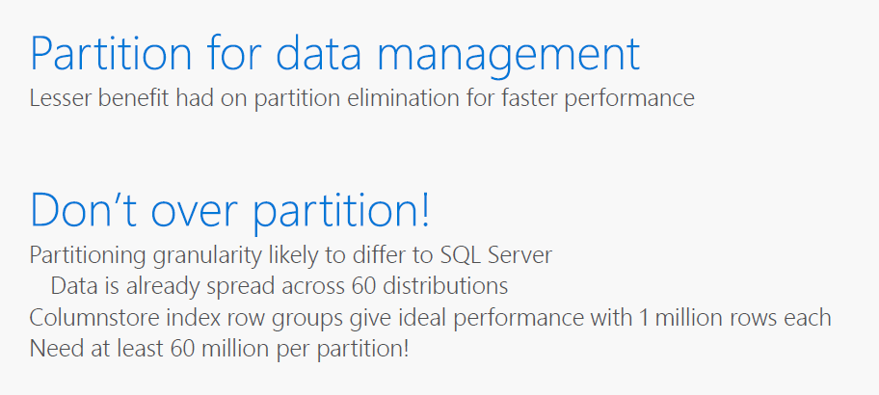
Partitioning Guidance

Slide 13
Loading Patterns

Slide 14
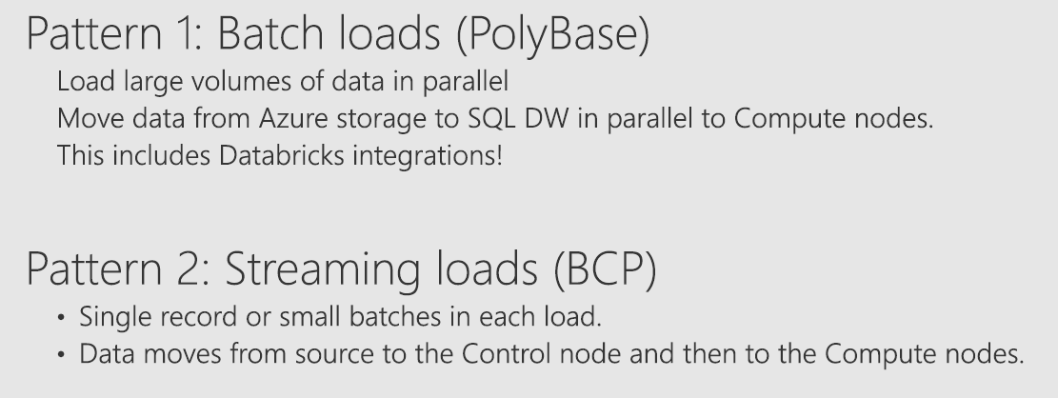
Loading Patterns

Slide 15
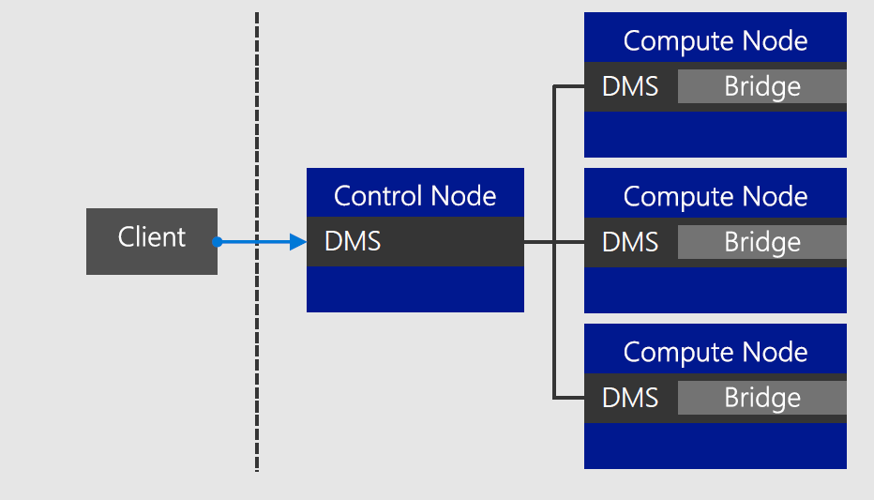
Single Gated Client

Slide 16
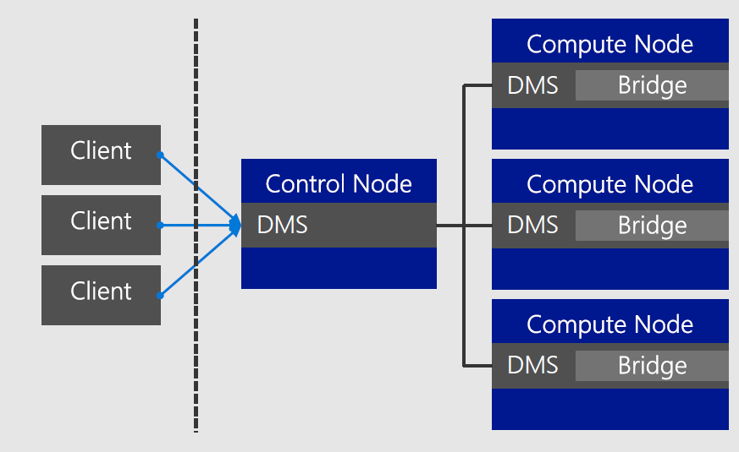
Single Gated Client Parallelized

Slide 17
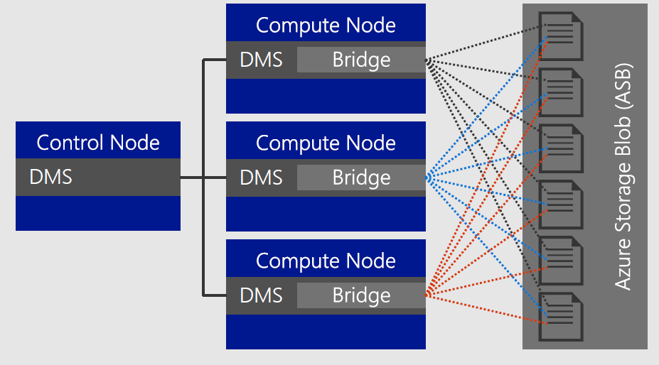
Polybase parallel load to Azure Storage Blob

Slide 18
Add in content Show the Polybase export commands and demo

Slide 19
Loading Tools

Slide 20
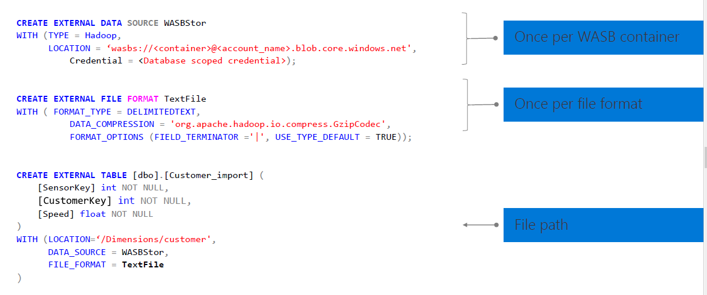
Create External Tables

Slide 21
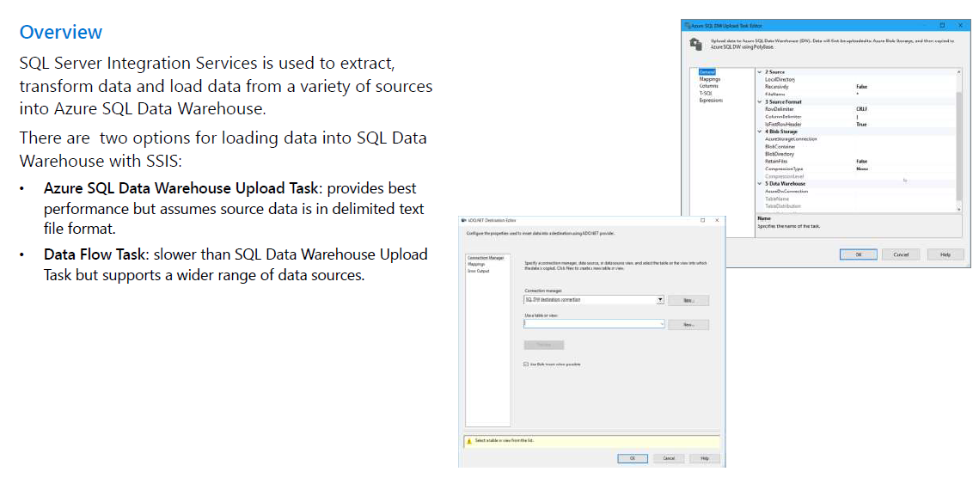
SQL Server Integration Services (SSIS)

Slide 22
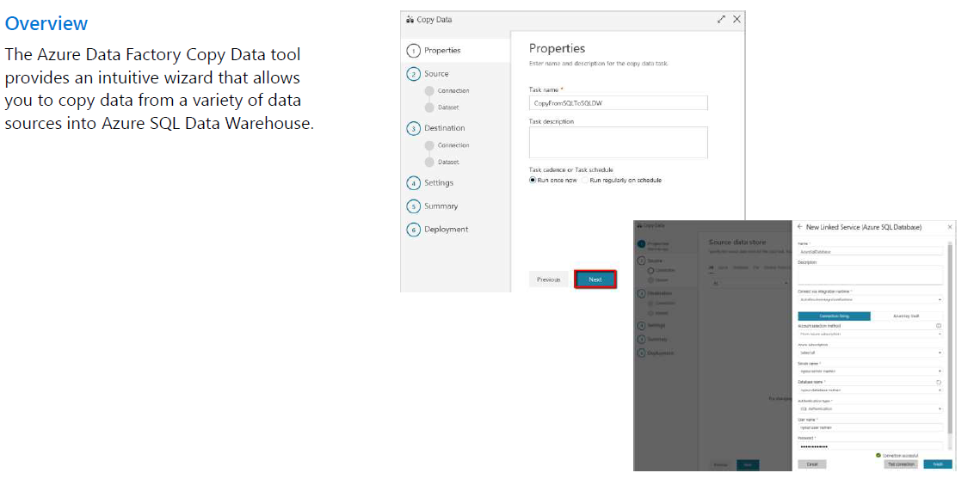
Azure Data Factory Copy Data Tool

Slide 23
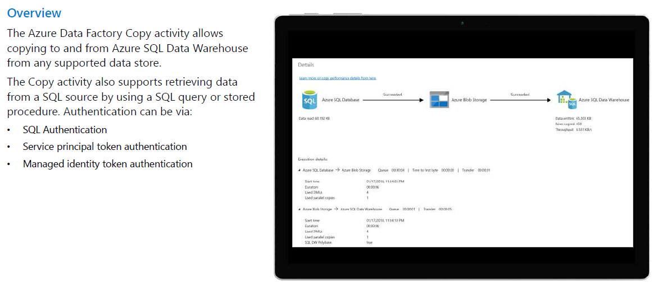
Azure Data Factory Copy Activity

Slide 24
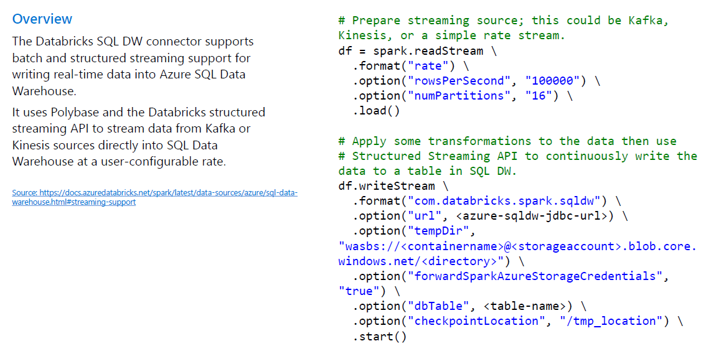
Data Bricks Streaming

Slide 25
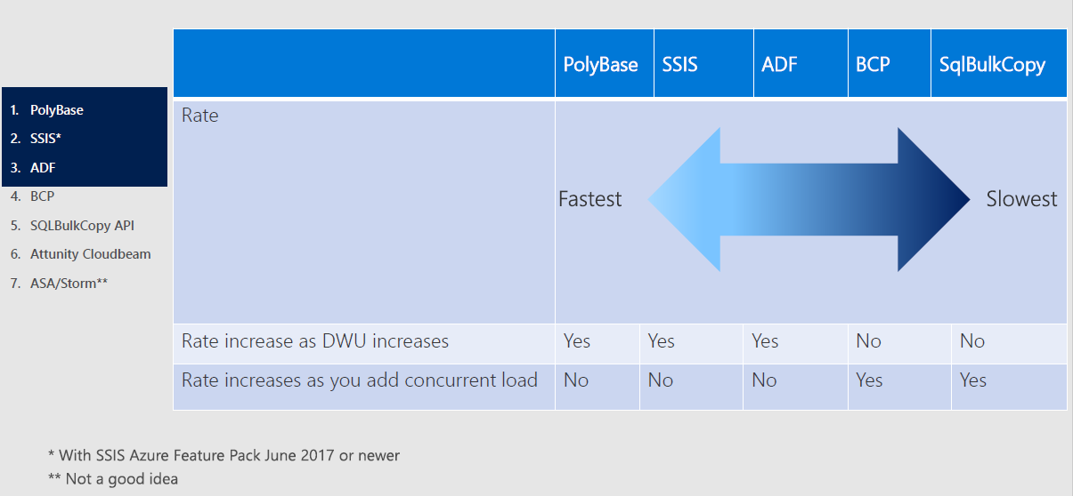
Mechanism for Loading

Slide 26
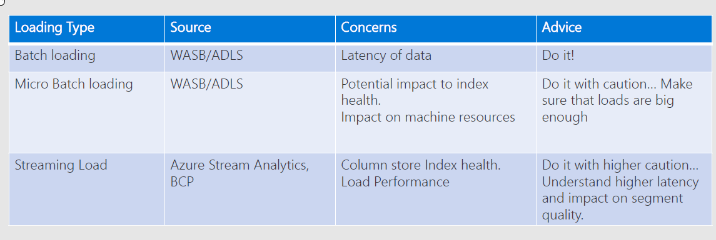
Loading Method Conciderations

Slide 27
Best Practices

Slide 28
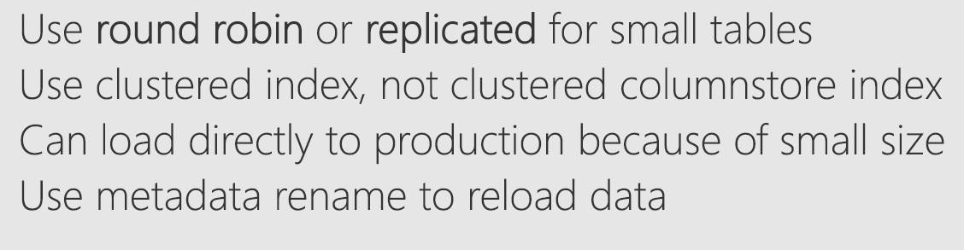
Dimension Tables – Best Practices

Slide 29
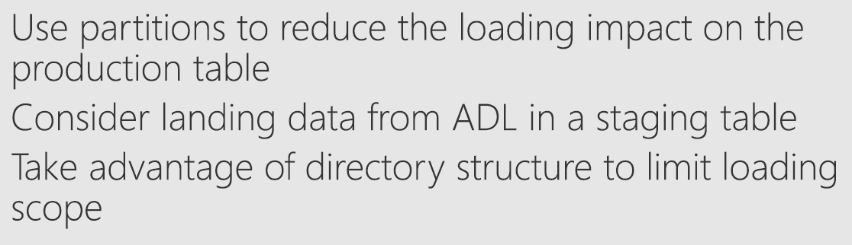
Fact Tables Best Practices

Slide 30
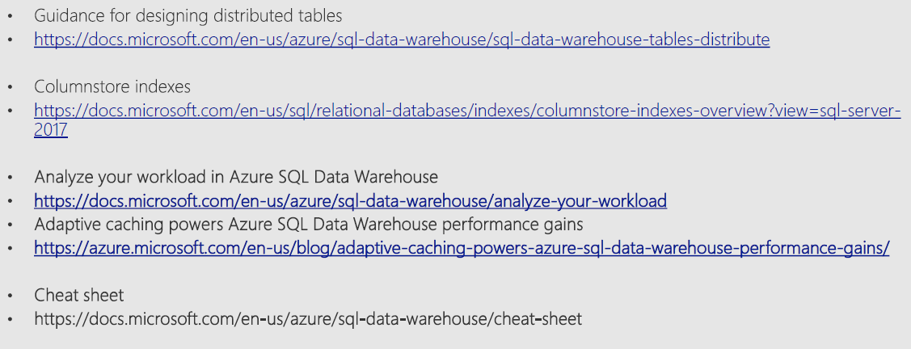
Additional Resources
TBD – Replace with links

Slide 31
Q&A

